Slide 1
Anggota Kelompok
YAHYA WILDAN
[ A11.2018.11462 ]
FEBRIAN MOCHAMAD ANDI SAPUTRA
[ A11.2018.11472 ]
SATRIO SUYO WIBOWO
[ A11.2018.11482 ]
ANDIKA WAHYU RAMA ARDIANSYAH
[ A11.2018.11492 ]

Slide 2
PCG
< Program
Cash
Game >
SIMPLE AND EASY TO USE
ONLY FOR ONE GAME
VERY CHEAP
CAN’T EDIT DATA
FREE TO DETERMINE THE AMOUNT
ONLY SORTING BY ID

Slide 3
FLOWCHART
START
Typedef struct{
Int id;
Char nick [50];
Int dm;
Int harga;
Int code;
Int total;
}diamond;
y=0;
Diamond mlbb[50];
menu( );
pil==2
pil==1
Input (pil);
outputdata(mlbb );
inputdata(mlbb );

Slide 4
pil==3
menu_search( );
pil_id==2
pil_id==1
Input (pil_id);
searc_nick(mlbb);
searc_id(mlbb);
pil_id > 3
Pil_id != 3
output (“Notif error ”);

Slide 5
pil==4
menu_sorting( );
pil_dm==2
pil_dm==1
Input (pil_dm);
sort_dm_des(mlbb);
sort_dm(mlbb);
pil_dm > 3
Pil_dm != 3
output (“Notif error ”);

Slide 6
default
pil==6
pil==5
output (“Notif error ”);
Thanks(mlbb );
exit(0);
output_nota(mlbb );
END

Slide 7
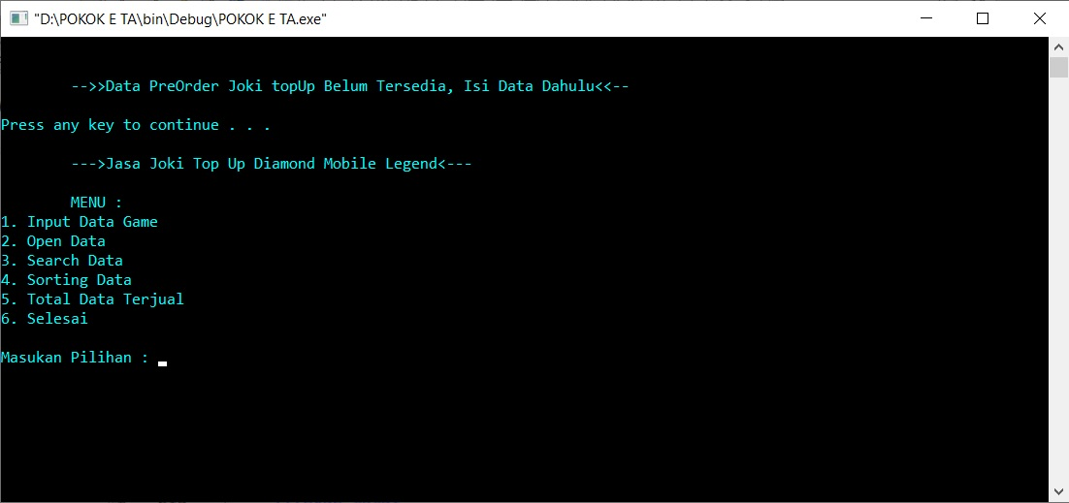
Place your screenshot here

Slide 8
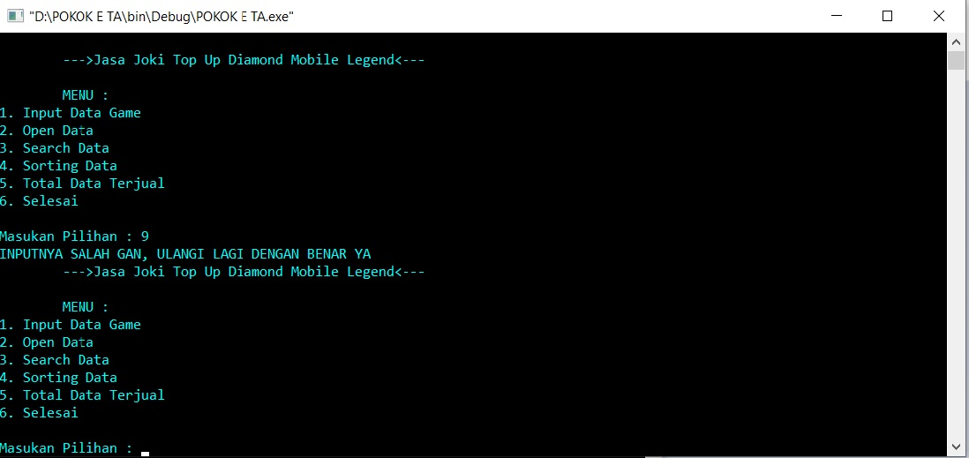
Place your screenshot here

Slide 9
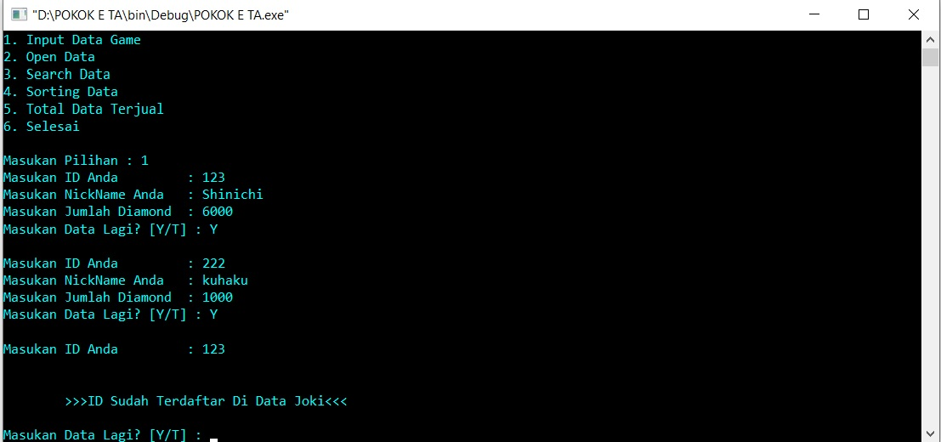
Place your screenshot here

Slide 10
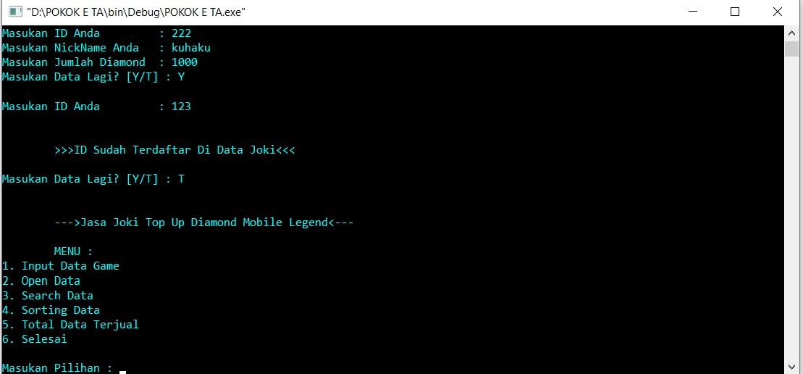
Place your screenshot here

Slide 11
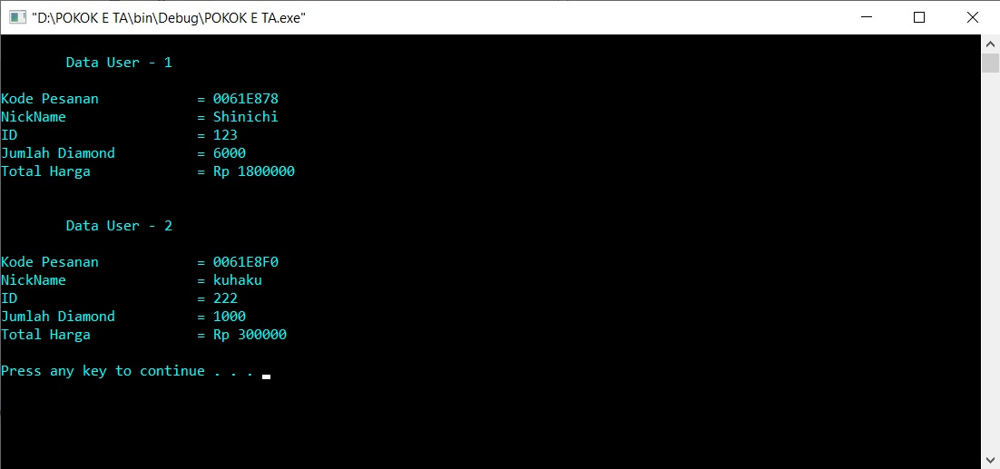
Place your screenshot here

Slide 12
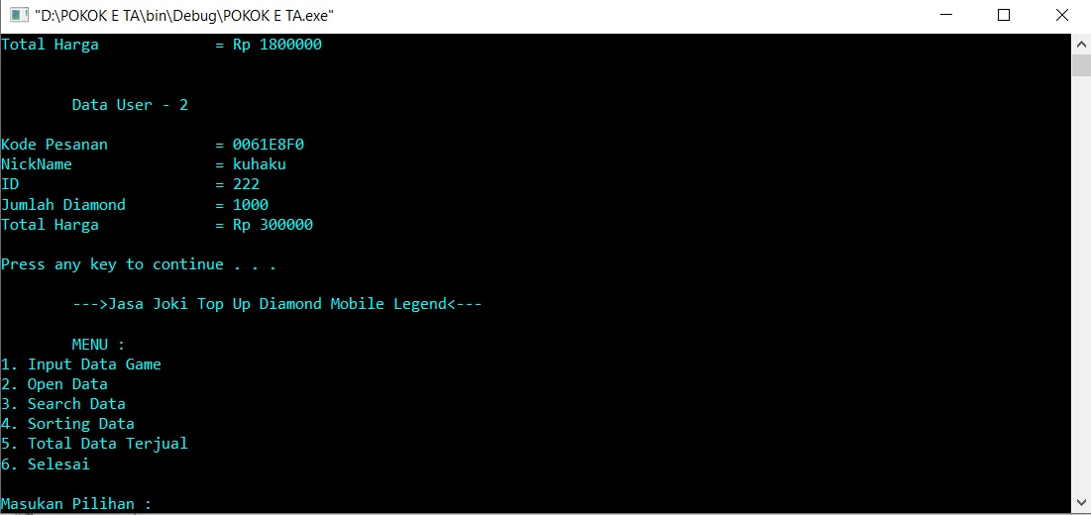
Place your screenshot here

Slide 13
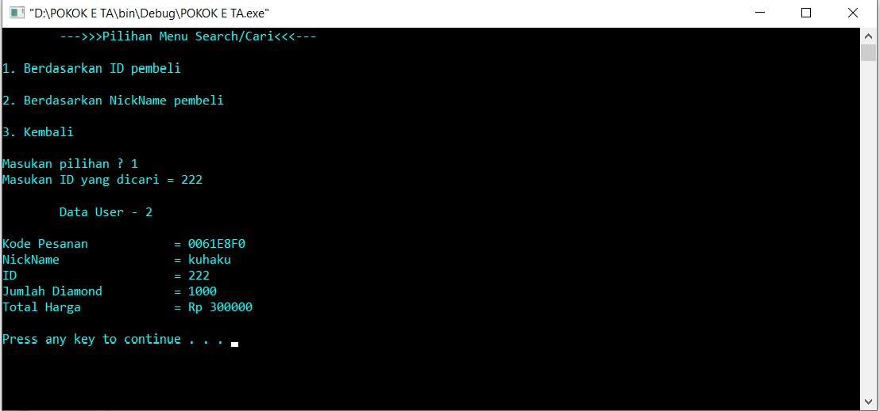
Place your screenshot here

Slide 14
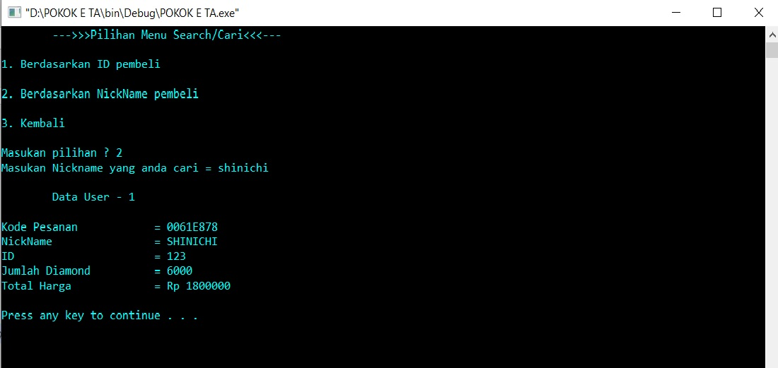
Place your screenshot here

Slide 15
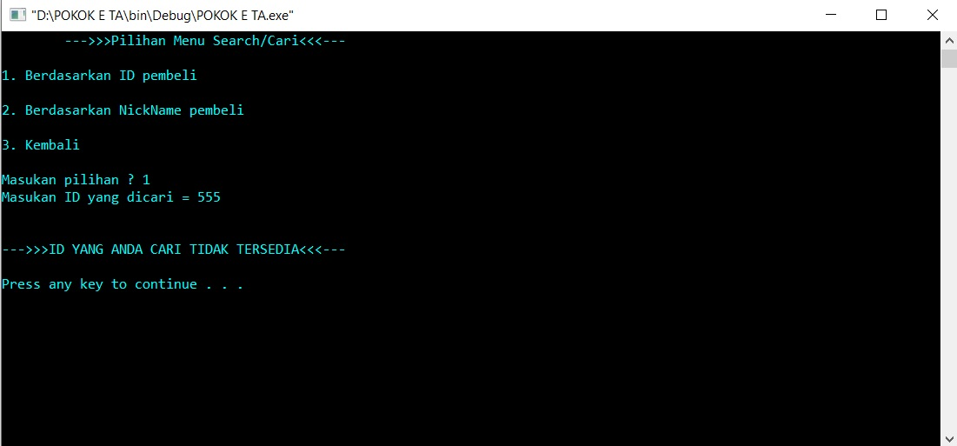
Place your screenshot here

Slide 16
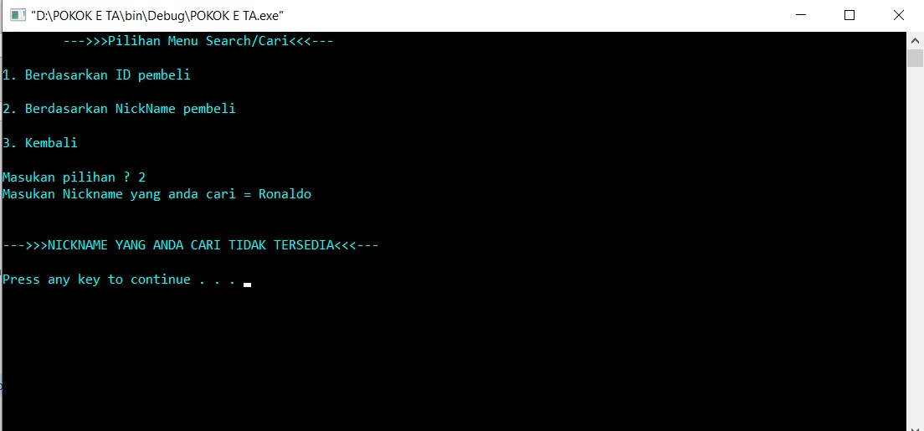
Place your screenshot here

Slide 17
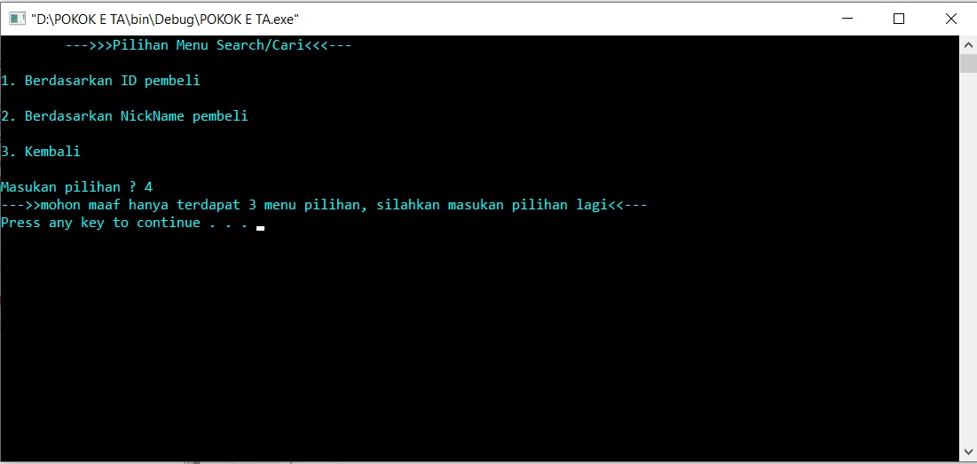
Place your screenshot here

Slide 18
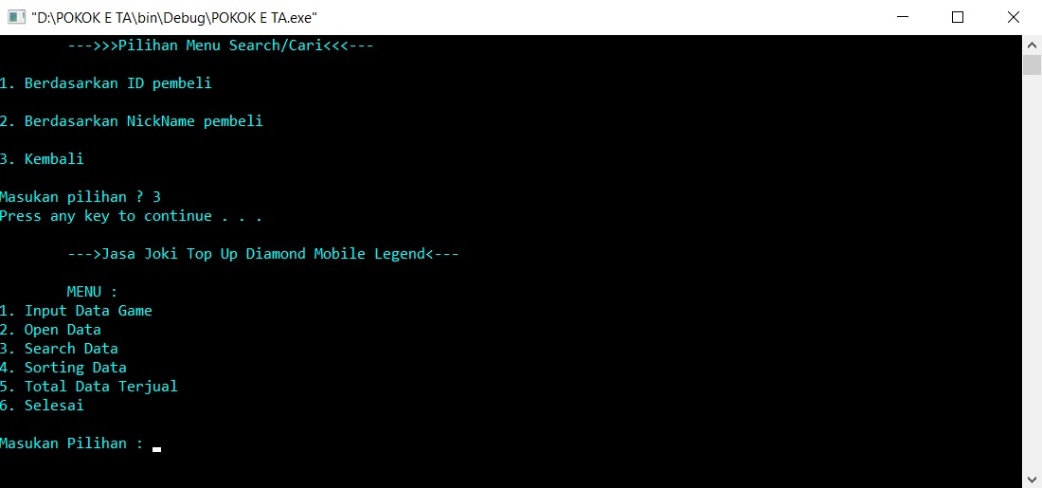
Place your screenshot here

Slide 19
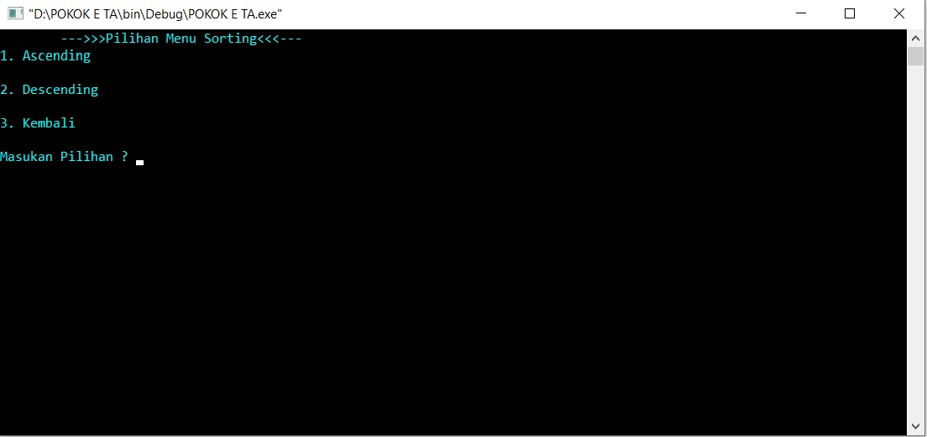
Place your screenshot here

Slide 20
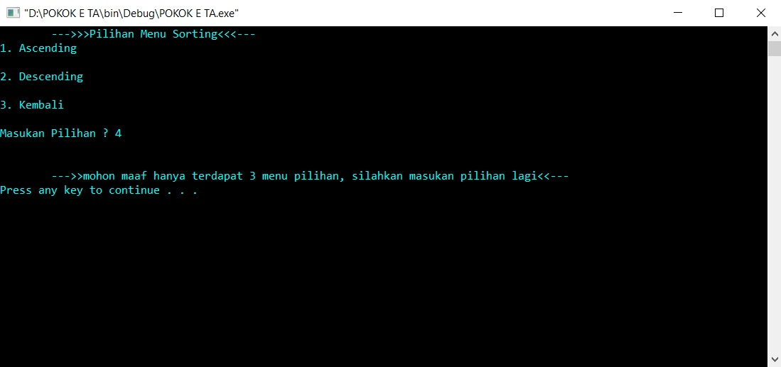
Place your screenshot here

Slide 21
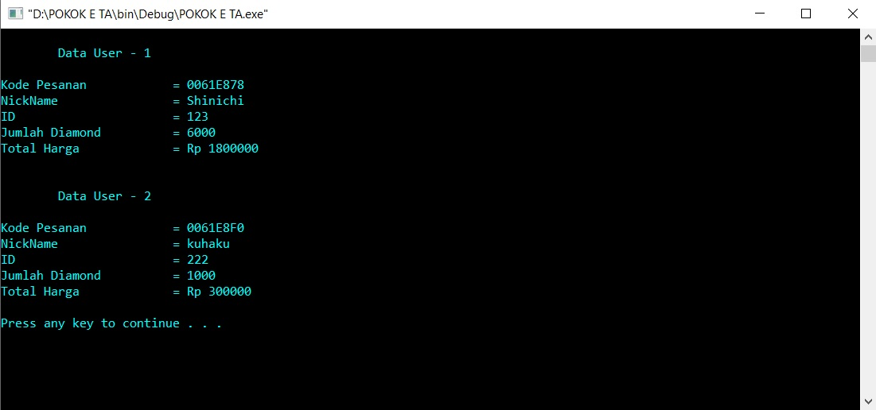
Place your screenshot here

Slide 22

Place your screenshot here

Slide 23
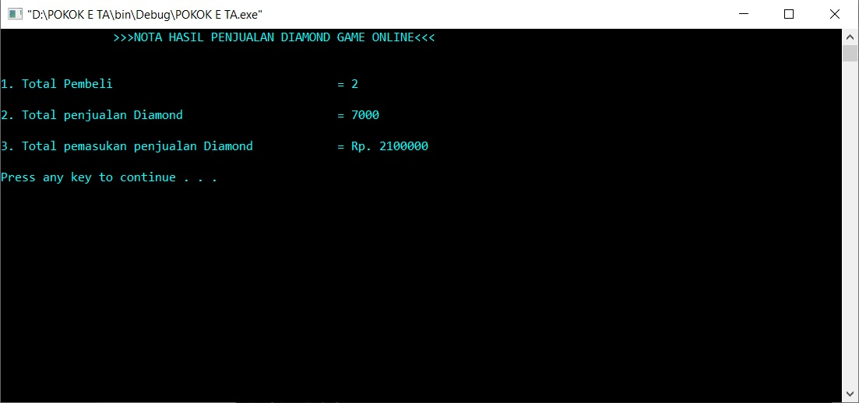
Place your screenshot here

Slide 24
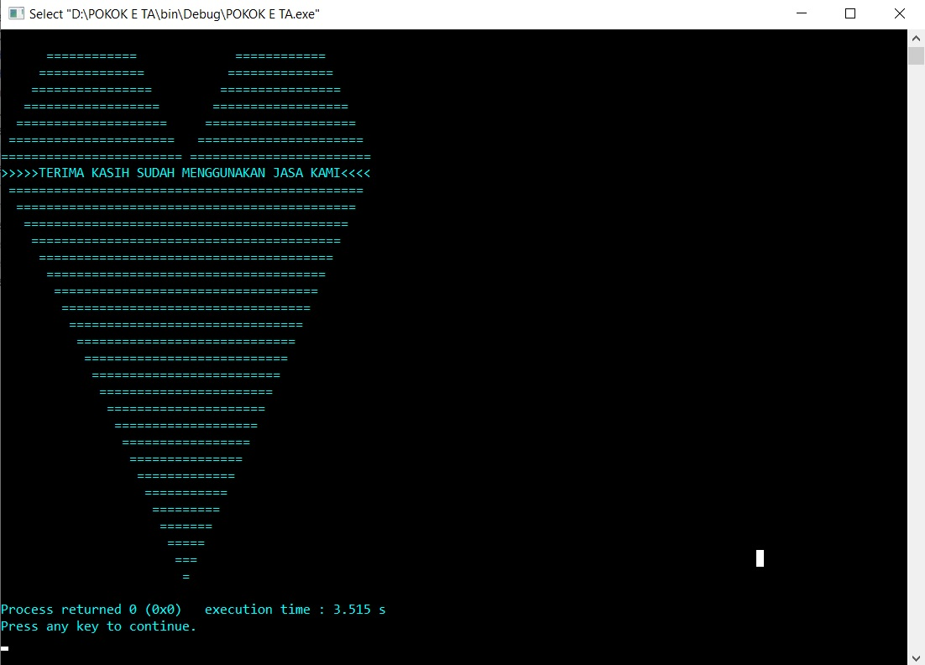
Place your screenshot here

Slide 25
KESIMPULAN
PcG (Program Cash Game) adalah program yang sejenis dengan Unipin dan CodeShop, kelebihan dari program ini memberikan keleluasaan pada user untuk menginputkan jumlah diamond yang akan dibeli.
Isi dari Program Cash ini memiliki beberapa fitur, yaitu :
Input Data
Open data
Search Data
Sorting Data
Total Data Terjual
Selesai

Slide 26
SARAN
Kami sebagai Developer program ini berharap semoga program yang kami kembangkan dapat mempermudah user/pembeli yang ingin membeli diamond dengan jumlah sesuka hati.

Slide 27
Thanks!
ANY QUESTIONS?
😂 😉 😋 😒 😭 👶

Slide 28
SlidesCarnival icons are editable shapes. This means that you can:
Resize them without losing quality.
Change fill color and opacity.
Change line color, width and style.
Isn’t that nice? :) Examples:

Slide 29
😉
Now you can use any emoji as an icon! And of course it resizes without losing quality and you can change the color. How? Follow Google instructions https://twitter.com/googledocs/status/730087240156643328
✋👆👉👍👤👦👧👨👩👪💃🏃💑❤😂😉😋😒😭👶😸🐟🍒🍔💣📌📖🔨🎃🎈🎨🏈🏰🌏🔌🔑 and many more...

